Slide 1

Blast Strike
Team Members:
Seyit KOYUNCU-201911036
Mehmet Emir HOCAOĞLU-201911029
Nadide SOLMAZ-201911056
Zeynep Deniz DÖNMEZ-202011012
Alperen Kaan SALT-201911052
Advisor:
Dr. Öğr. Üyesi Serdar Arslan

Slide 2
Contents
Company Information
What is our Project?
Technical Details
Tests and Results

Slide 3

SINOPSIS
Sinopsis is a software company that solve large scale software and big data challenges for clients to help them become a truly digital business.

Slide 4

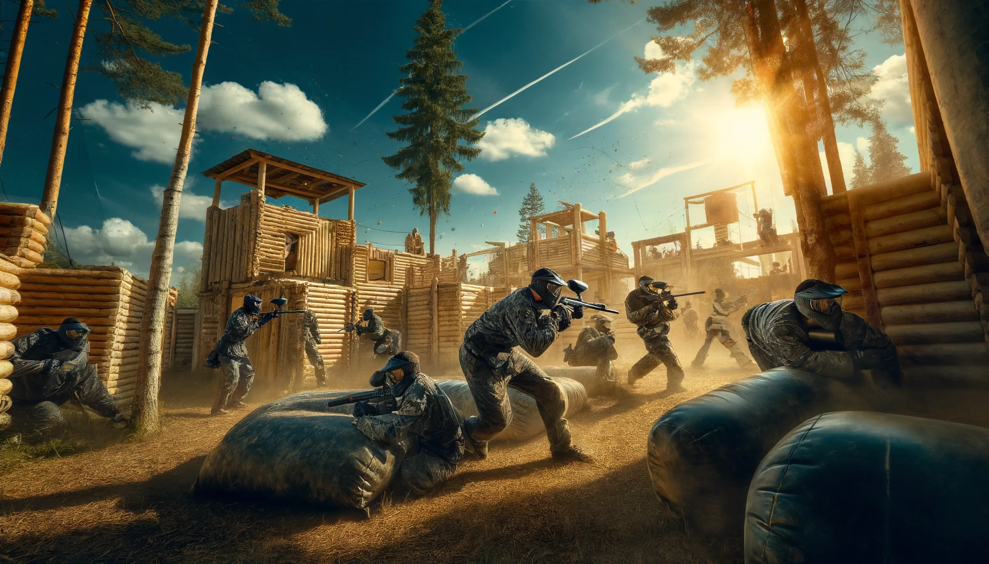
What Is Our Project?
Real-time Mobile FPS Game

Slide 5
Technical Details
Body Segmentatıon
Backend Servıce
GPS

Slide 6
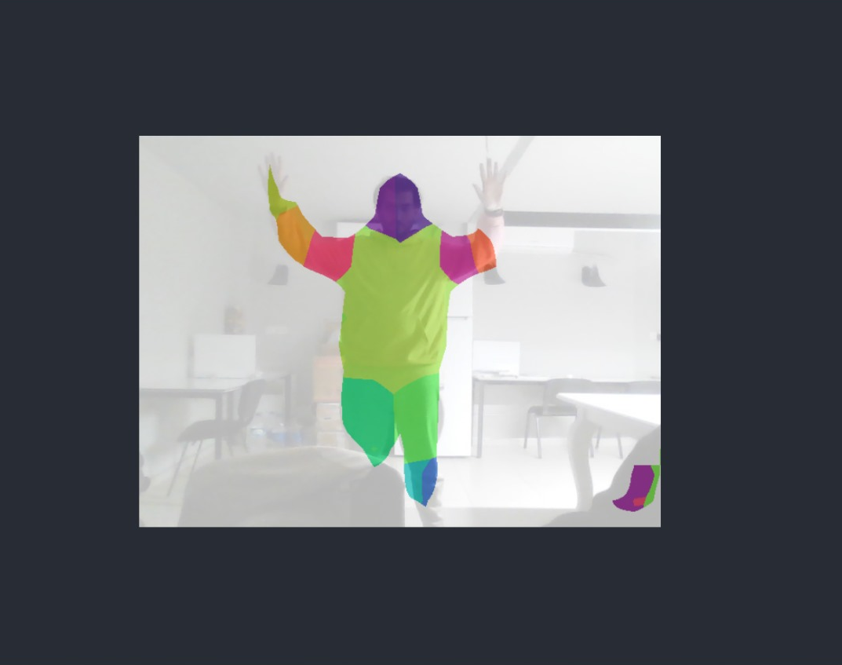
Body Segmentation

Slide 7
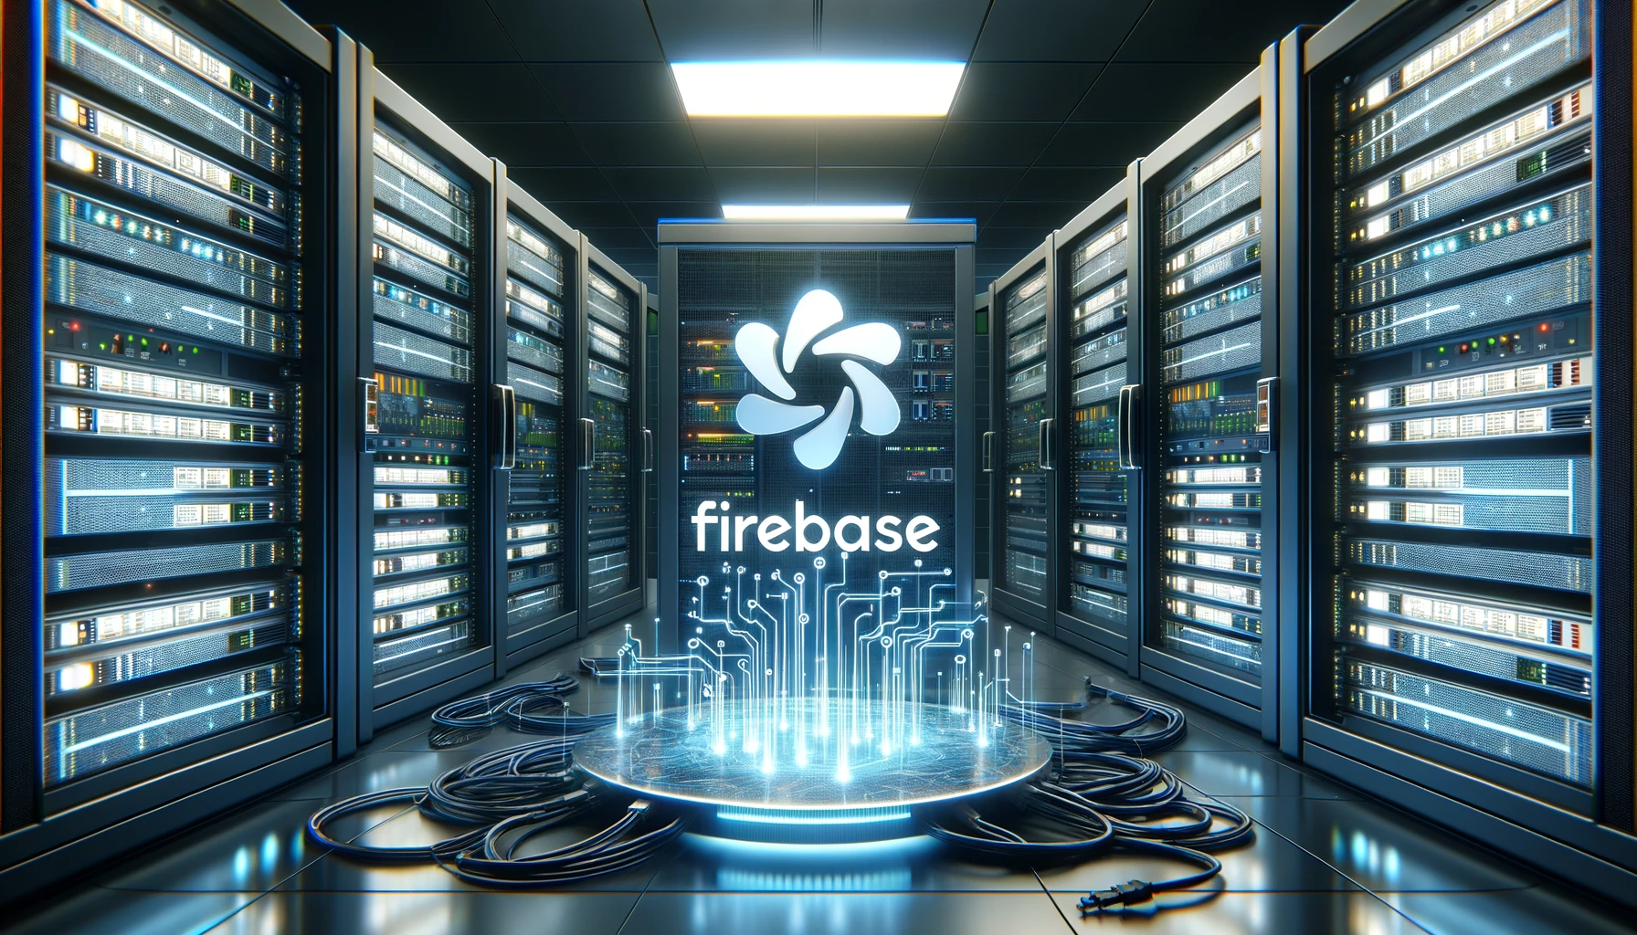
Backend Services

Slide 8

How to Solve GPS Problem?
Latitude and Longitude Coordinates
Bearing
Haversine Formula

Slide 9

Tests and Results

Slide 10

Questions?

Slide 11
